Slide 1
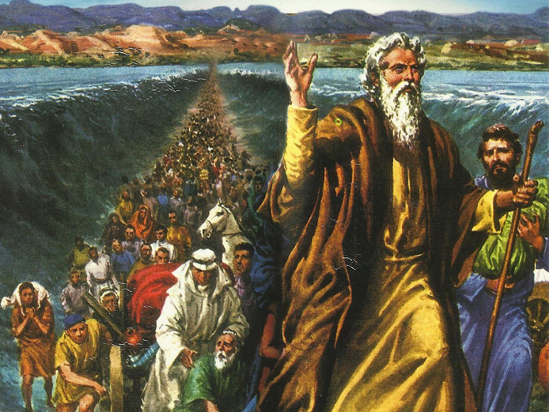
CATECHETICAL TEXTBOOK SERIES OF THE SYRO - MALABAR CHURCH
ON THE PATH OF SALVATION - 5
PEOPLE WHO AWAITED THE REDEEMER
5

Slide 2
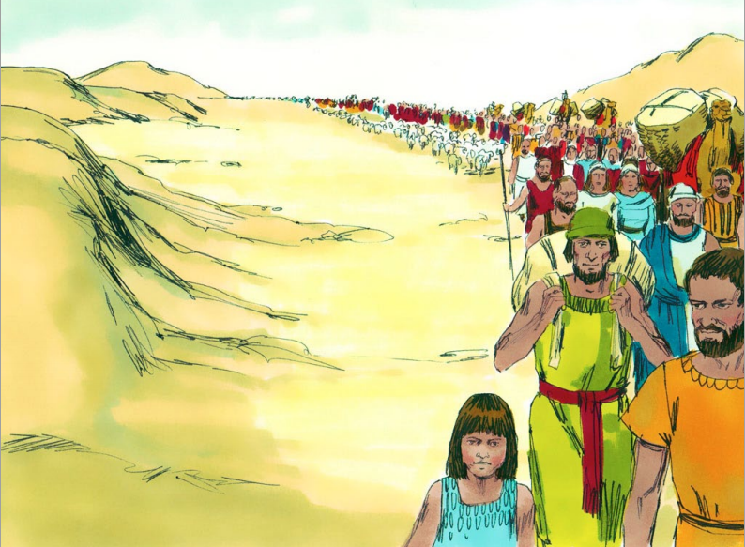
LESSON 7
THROUGH THE DESERT

Slide 3
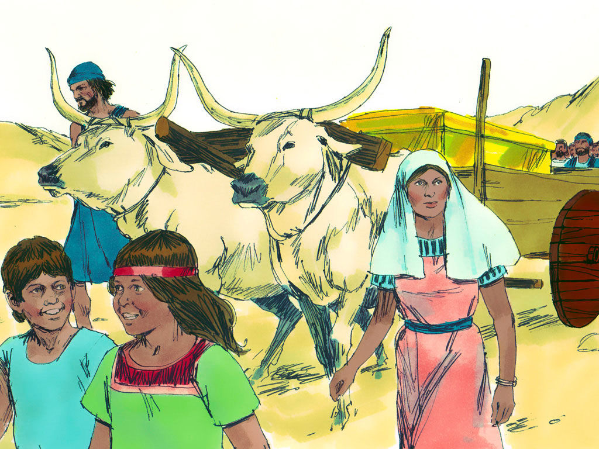


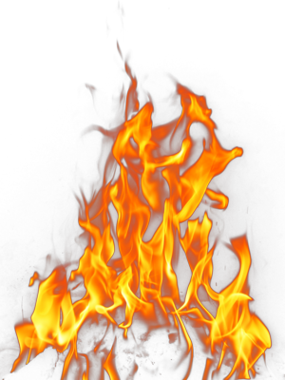
The people of Israel, after crossing the desert, continued their journey with great expectation. Their dream was the promised land of Canaan. The Lord was guiding them and protecting them every step of the way. “The Lord Went in front of them in a pillar of cloud by day, to lead them along the way, and in a pillar of fire by night, to give them light, so that they might travel by and by night. Neither the pillar of cloud by day nor the pillar of fire by night left its place in front of the people” (Ex. 13: 21-22).

Slide 4
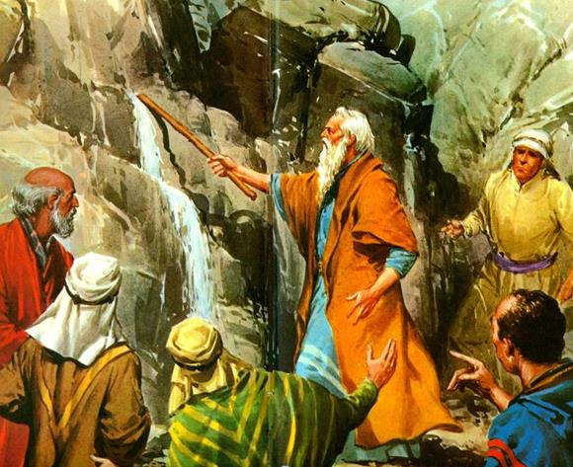
The water of marah
After crossing the sea even though they walked for three days through the Shur desert they couldn’t find water anywhere. At last they found water at a place called Marah but was too bitter to drink. People began to murmur against Moses. He called upon the Lord asking: “ What shall we drink? The Lord showed him a piece of wood. When he put it into the water it became sweet (Ex. 15:24-25).

Slide 5
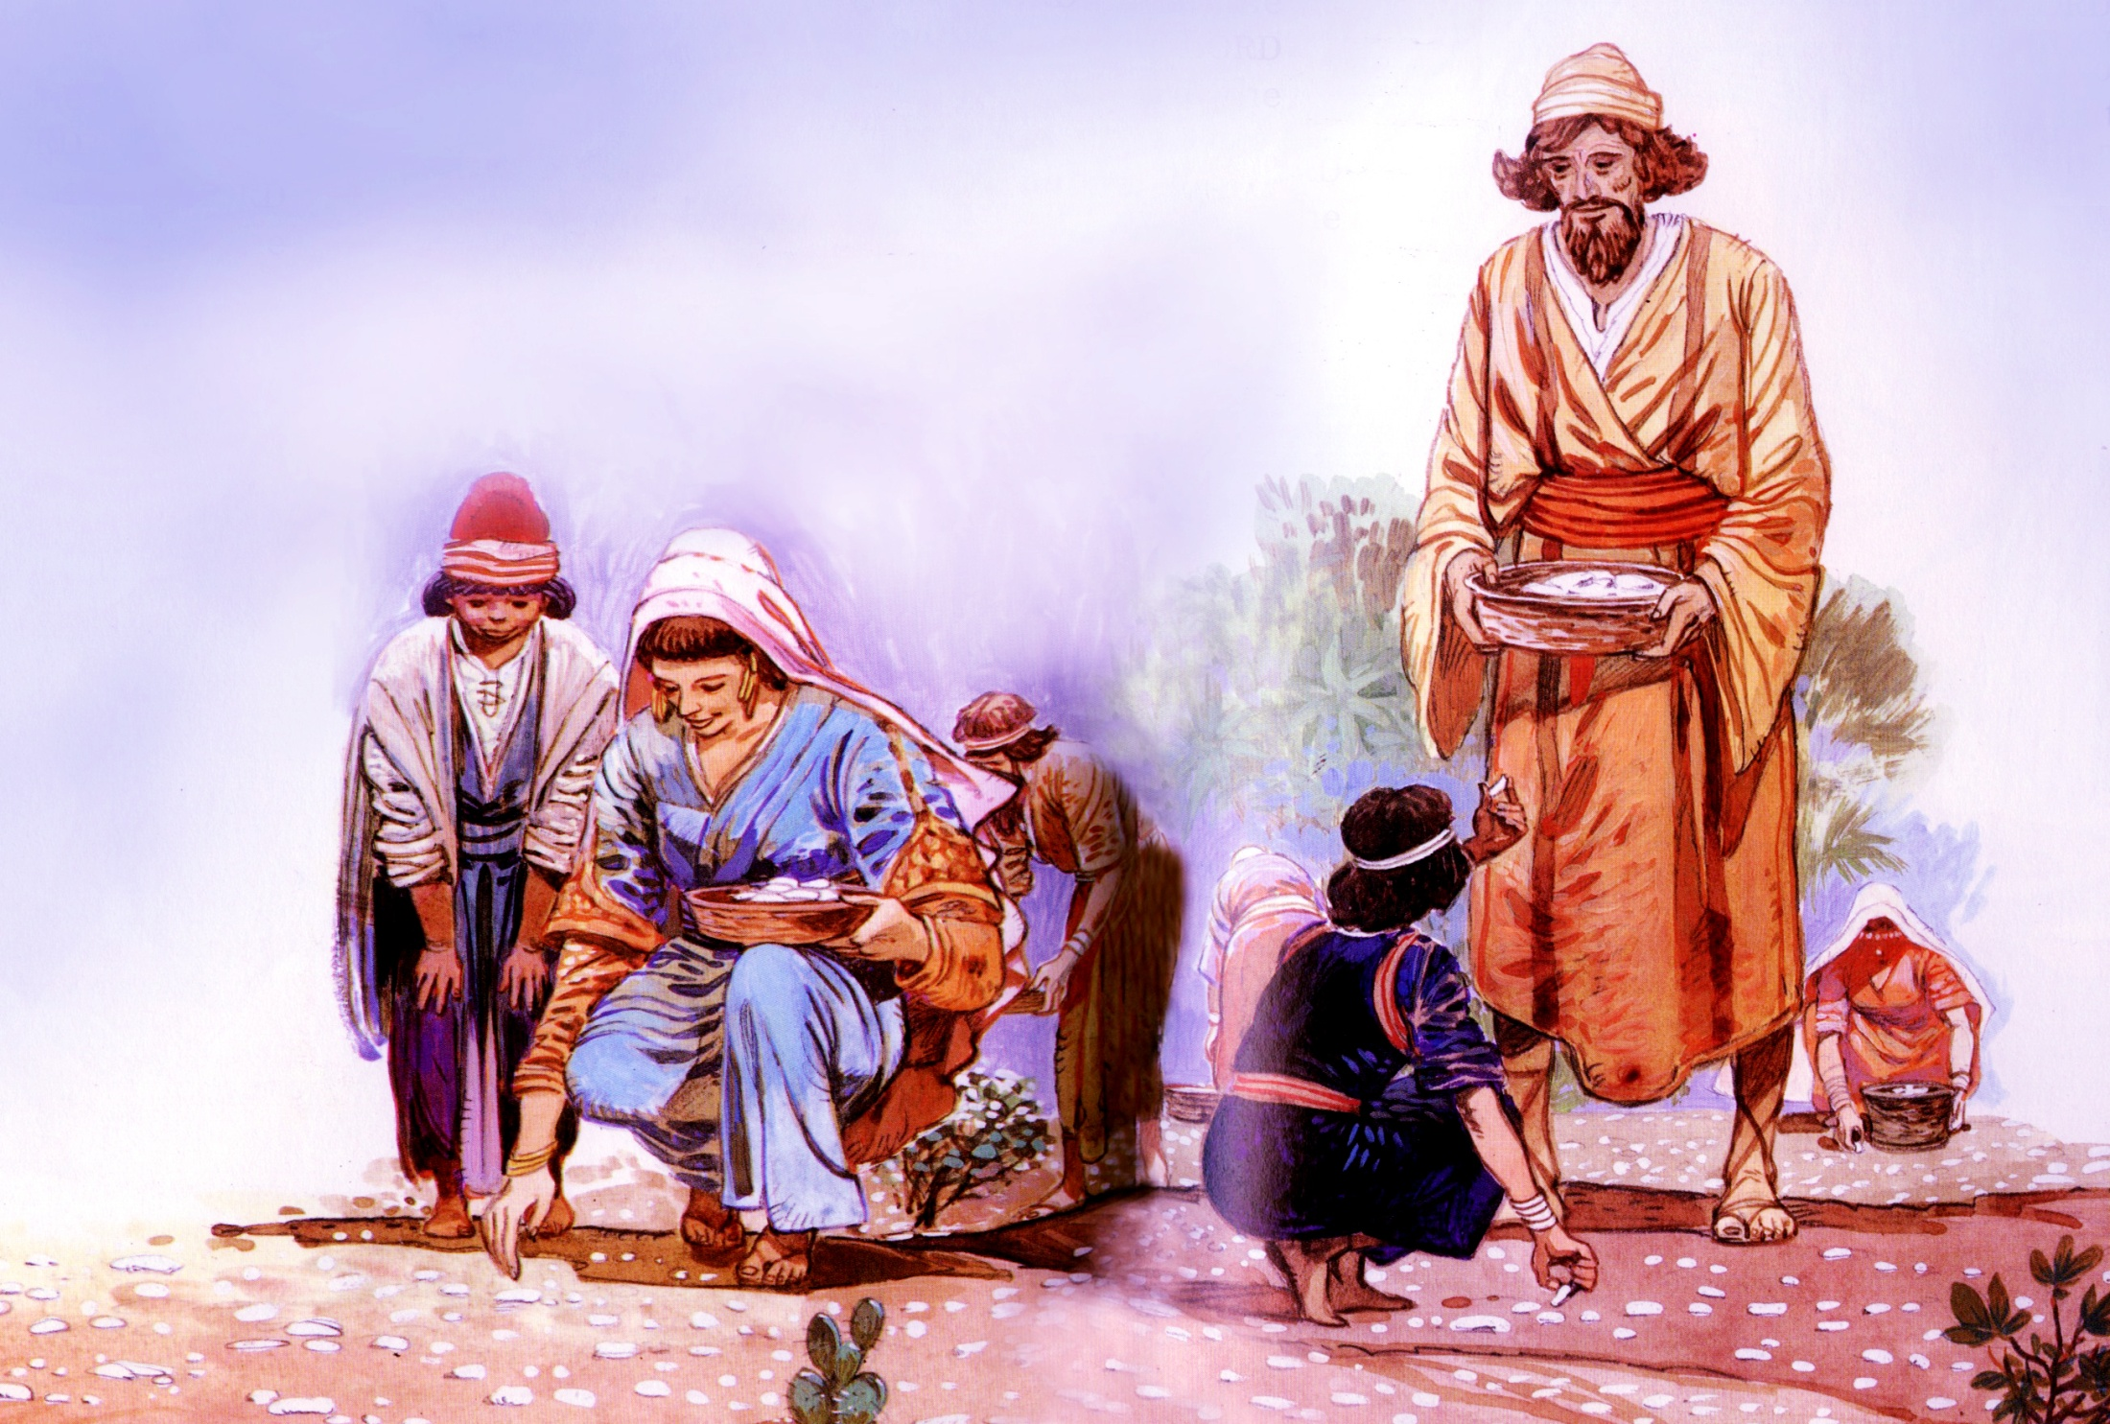

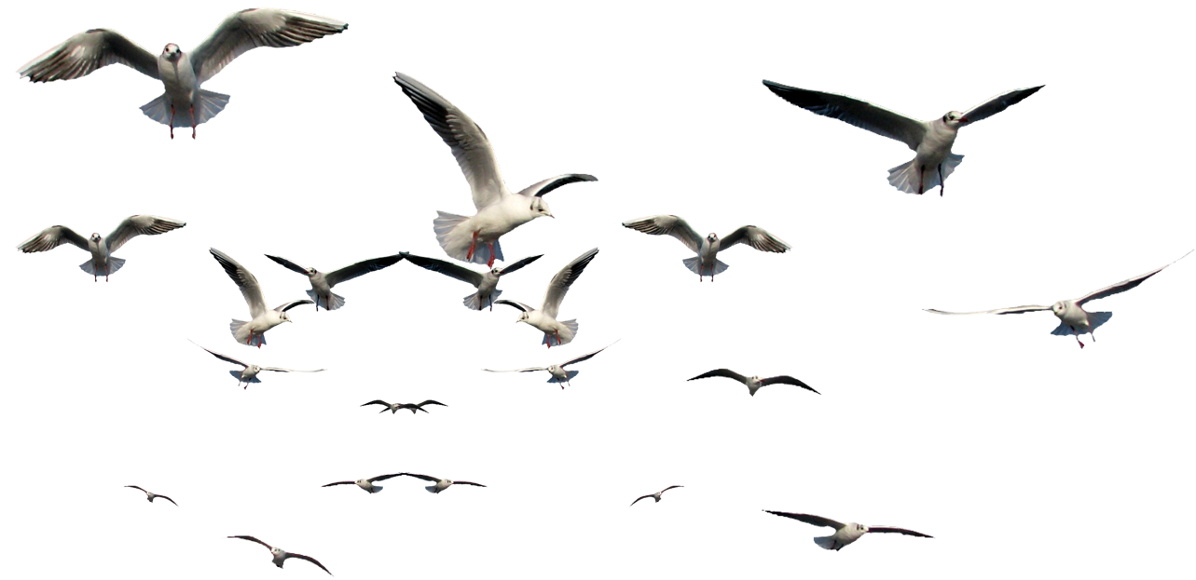
Manna and quails
God saw the hardships of the Israelites. He gave them plenty to eat, in the morning and evening. In the morning they got something like frosty wafers. All were surprised to see this strange thing on the ground and asked one another ‘ man ha, man ha’ meaning in their language, ‘ What is it?’ That is how the bread from heaven came to be called manna. They collected plenty of it and ate their fill.

Slide 6
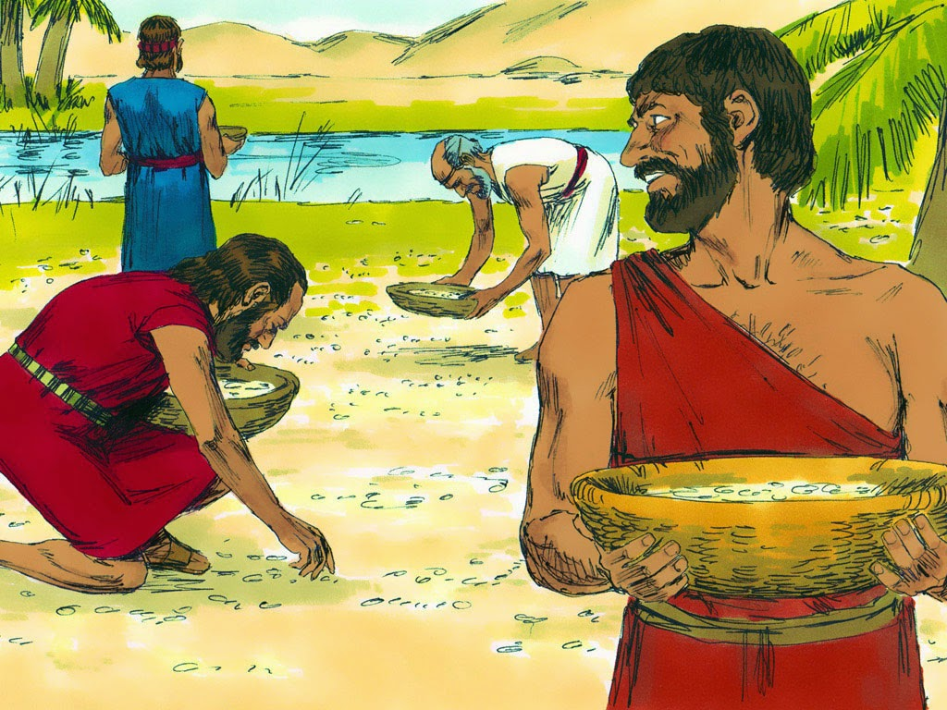
Manna looked like coriander seed, white in color and tasted like wafers of bread soaked in honey (Num. 11:7). It was their food for forty years, till they reached the land of Canaan. In the evening they could catch plenty of quails and they enjoyed their tasty meat.

Slide 7
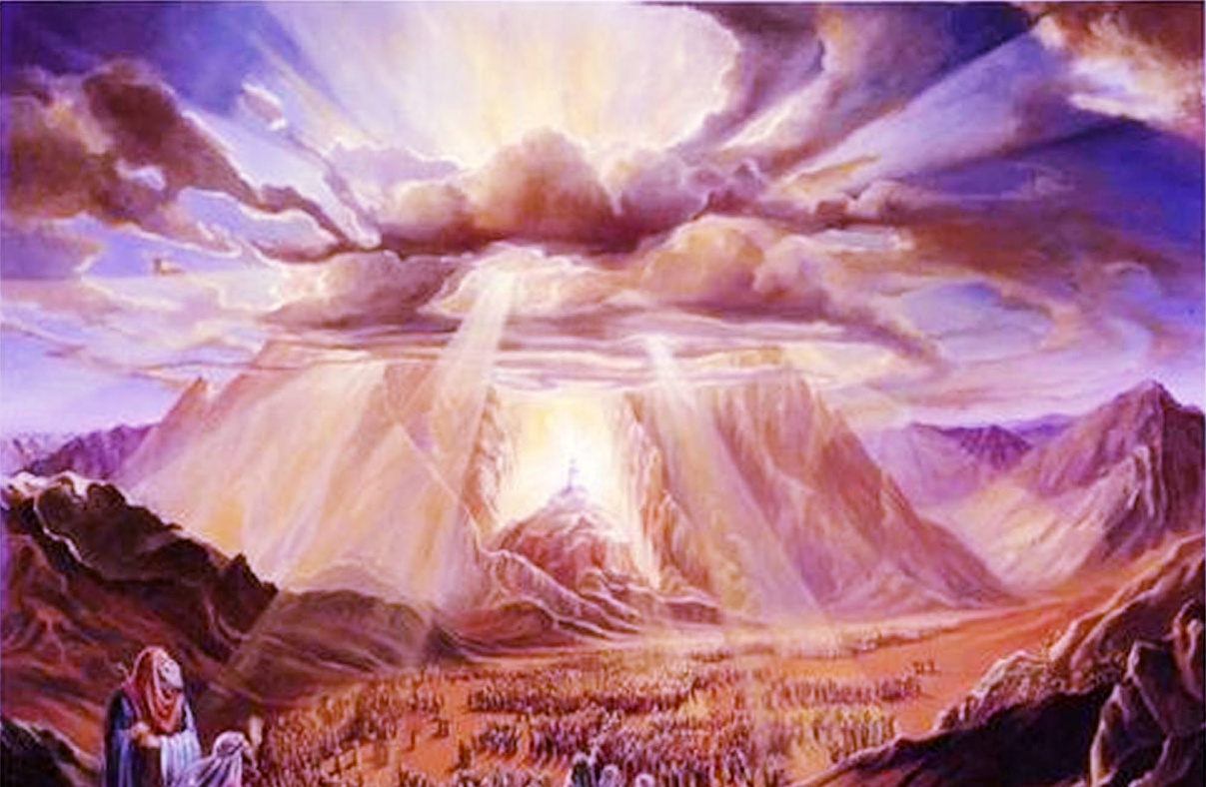
The covenant of sinai
When the people of Israel, walking through the desert, reached the base of mount Sinai and camped there, God called Moses from the Mountain and said: you o and tell the people of Israel: ‘If you obey my voice and keep my covenant, you shall be my treasured possession out of all the peoples’.

Slide 8
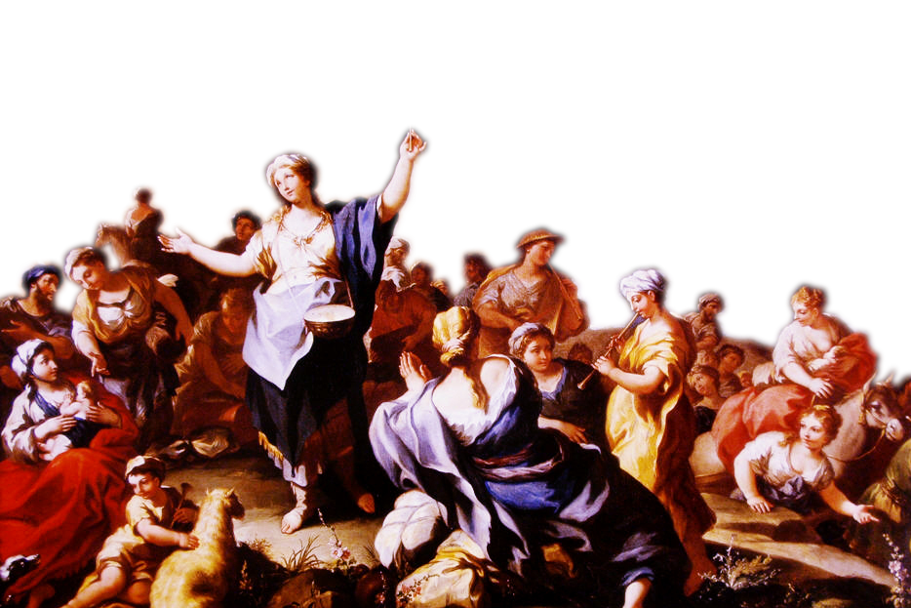
Moses called elders of the people and explained to all that the lord had told him. The people said in one voice: ‘Everything that the Lord has spoken we will do’. (Ex. 19:8). Then God established the covenant with them and as a symbol of covenant He gave them the commandments.

Slide 9
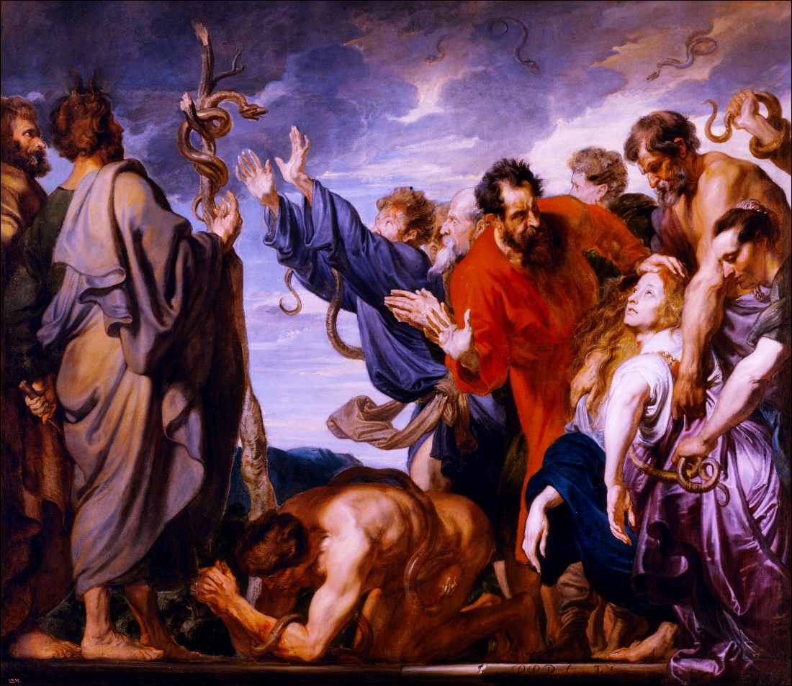
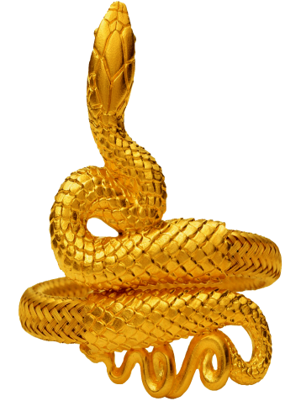
The serpent of the desert
So Moses made a serpent of bronze and put it upon a pole; and whenever a serpent bit someone, that person would look at the serpent of bronze and live (Num. 27: 7-9).

Slide 10
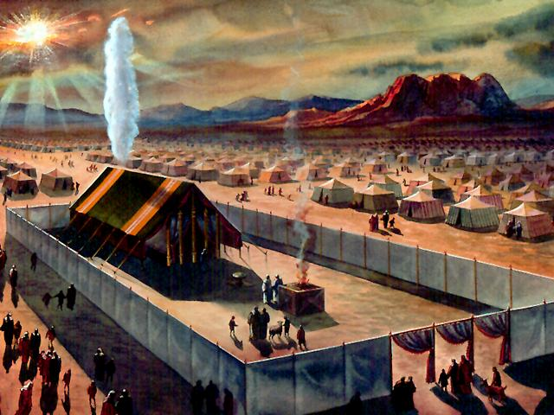
The tent of meeting
God continued His plan of salvation through the people of Israel. During the Journey in the wilderness Moses used to pitch his tent out side far off from the camp. Moses called it the tent of meeting God and Moses used to talk in this tent. We find a beautiful description of this in the book of Exodus (Ex.33:7-11).
When Moses entered the tent, the pillar of cloud would descend on the tent and stay at the door. Then God would talk to Moses.

Slide 11
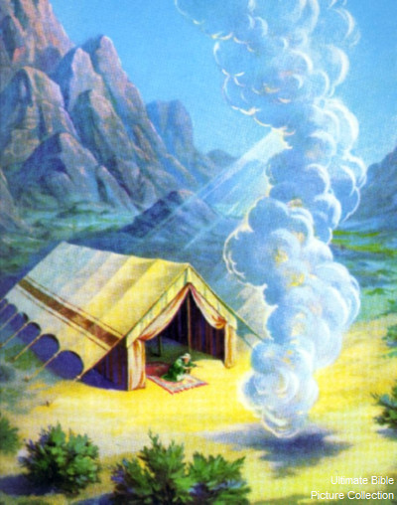
The lord with the people
“New, if I have found favour in your sight, show me your ways, so that I may know you and find favor in your sight” (Ex.33:13).
They considered this as the presence of the Lord. When the cloud lifted from above the tent they started on their journey. Wherever the cloud stopped they would stop and the tents of the camp.

Slide 12
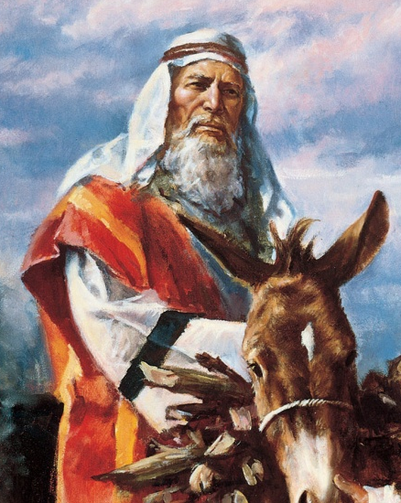

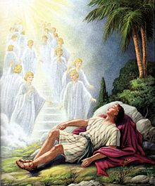
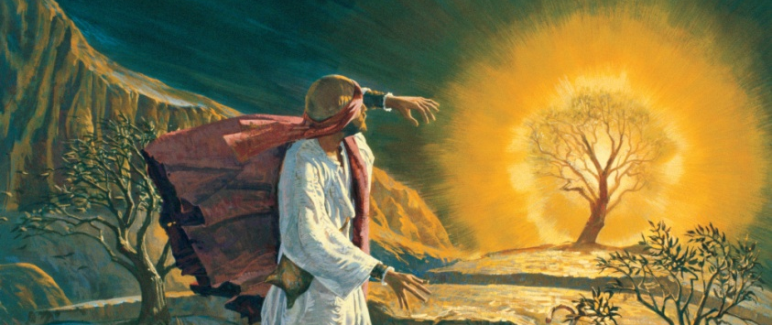
God’d guidance
Such as the Patriarchs, Abraham, Isaac and Jacob. Moses the leader of the people of Israel was also guided by God all along his way. As a people it was Israel that had the privilege of being directly guided by God.

Slide 13



MOSES GENEALOGICAL CHART
ABRAHAM
ISHMAEL
ISAAC
ESAU
JACOB
LEVI
GERSHON
KOHATH
MERARI
AMRAM
IZHAR
HEBRON
UZZIEL
AAROW
MOSES
MIRIAM

Slide 14
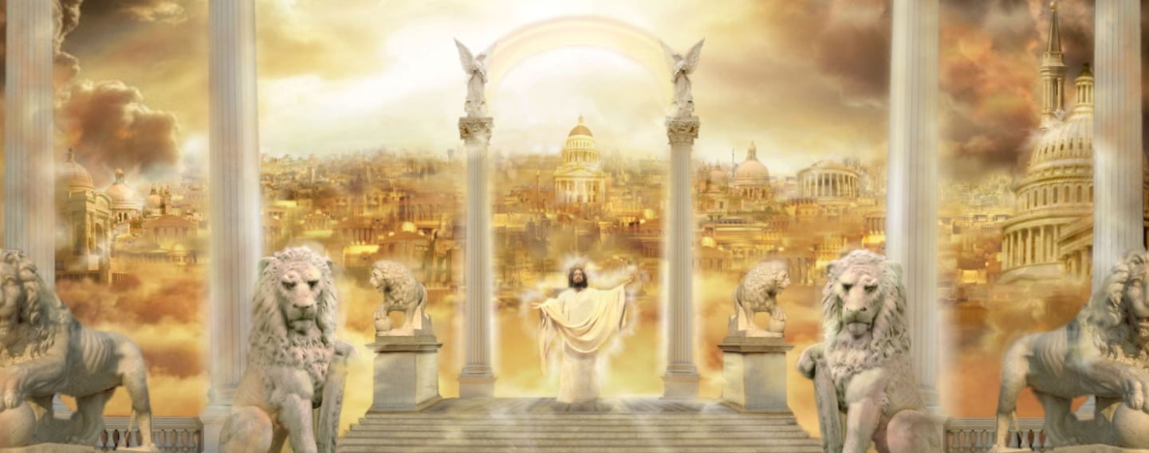
The pilgrim church
Even as Moses led the Israelites those days, the Church leads the believers today. The goal of the Church is to lead the faithful, the pilgrim people to the Kingdom of Heaven.
The ways of God are different from our ways. Even in the midst of hardships He leads us to salvation. When we face dangers He will protect us, for He is faithful. The history of Moses gives us the message that the Lord, who called strengthened and guided Moses, will strengthen and guide us also.

Slide 15
Let us pray
O God who guided the Israelites through the wilderness, lead us also in our journey towards the heavenly home.

Slide 16
READ AND RECOUNT
Narrate the event of Moses and bronze serpent.
(Numbers 21:1-9)

Slide 17

WORD OF GOD FOR GUIDANCE
“ I myself will come with you; and I will give you rest ” (Exodus 33:14).

Slide 18
MY DECISION
Like the Israelites who followed the way shown by God, I will also follow the way shown by God.

Slide 19
LET US DO
Write the first two sentences from the song of Moses (Exodus 15:1-2).

Slide 20
LET US FIND OUT THE ANSWER
1. How did God guide the Israelites day and night after they left the land of Egypt?
2. What was the food God gave the Israelites in the desert?
3. What is the meaning of the word Manna?
4. What is the speciality of the ark of the Covenant?
5. What is the message that the journey of the Israelites through the desert gives us?

Slide 21
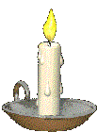


Thank you

